Slide 1

Change Detection Filtering with Visual Language Models
Eric Martinson, PhD
Igri Fishta
DISTRIBUTION STATEMENT A.
Approved for public release; distribution is unlimited. OPSEC # XXXX
(remove if not applicable)

Slide 2
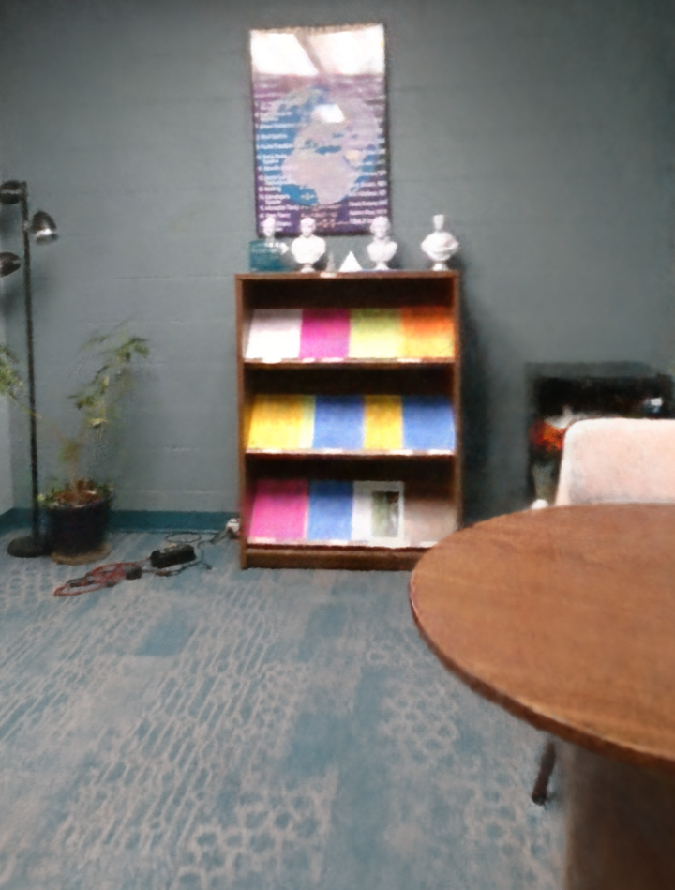

Challenge
Challenge: Military and autonomous systems capture massive volumes of video data that far exceed human analyst capacity.
Current Limitations:
Standard detectors (e.g., YOLO) are rigid and bound by the "labeling bottleneck".
Open-Vocabulary Object Detection (OVOD) models (e.g., CLIP, SAM 3) allow flexible queries, but streaming zero-shot detections generate excessive false positives and noisy flags.
“Before”
“After”
In repeated patrol scenarios, analysts shouldn't re-evaluate static background features—they should focus exclusively on what has changed.

Slide 3
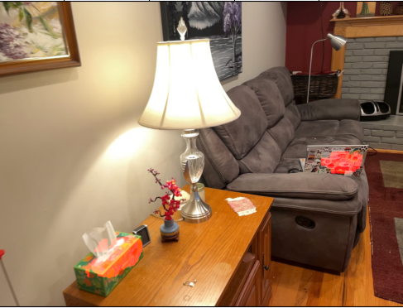
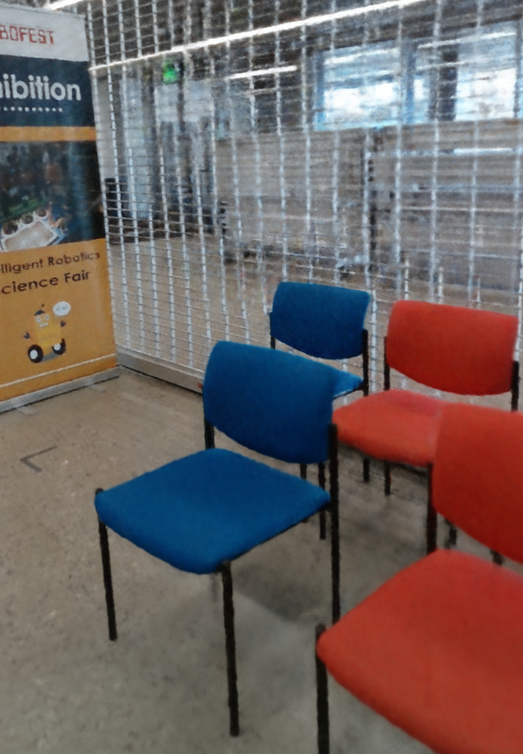
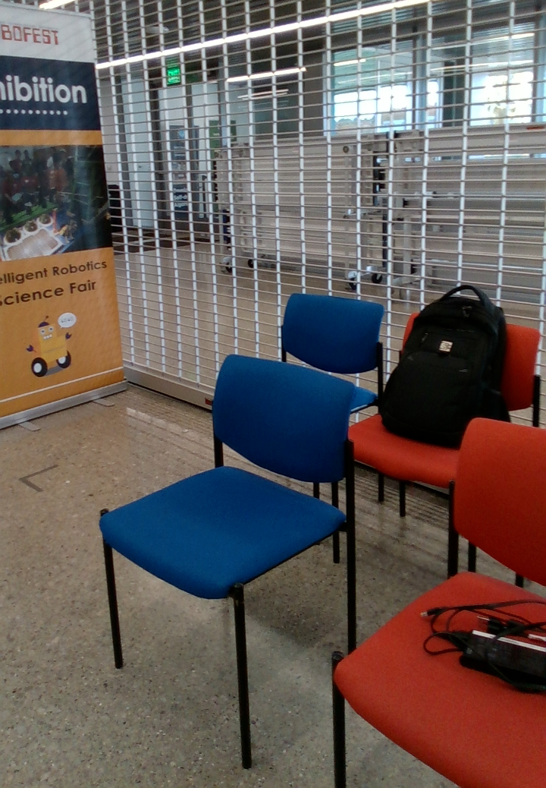
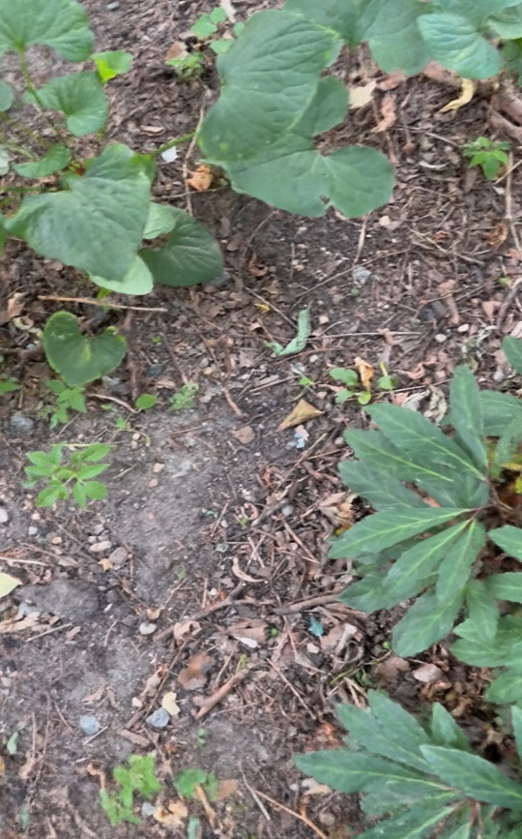
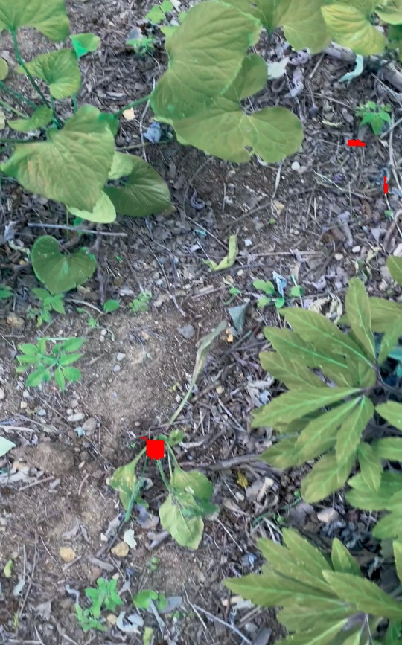
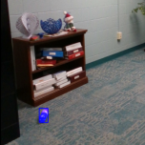
Proposed Solution
A hybrid pipeline combining spatial image registration, 3D point-cloud spatial filtering, and Visual Language Models (VLMs) for side-by-side change verification.
Key Achievements:
Discards up to 80%–90% of unchanged false-positive flags without impacting detection recall.
Works across heterogeneous hardware (handheld monocular phone cameras and RGB-D equipped robotic platforms).

Slide 4
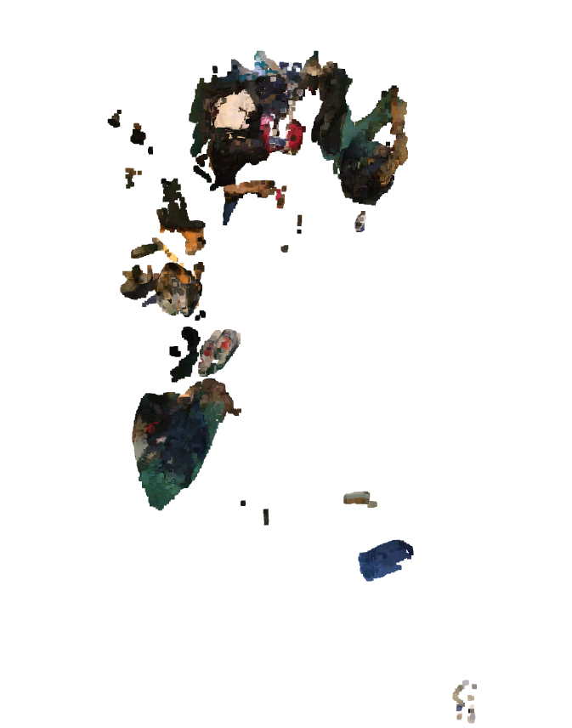
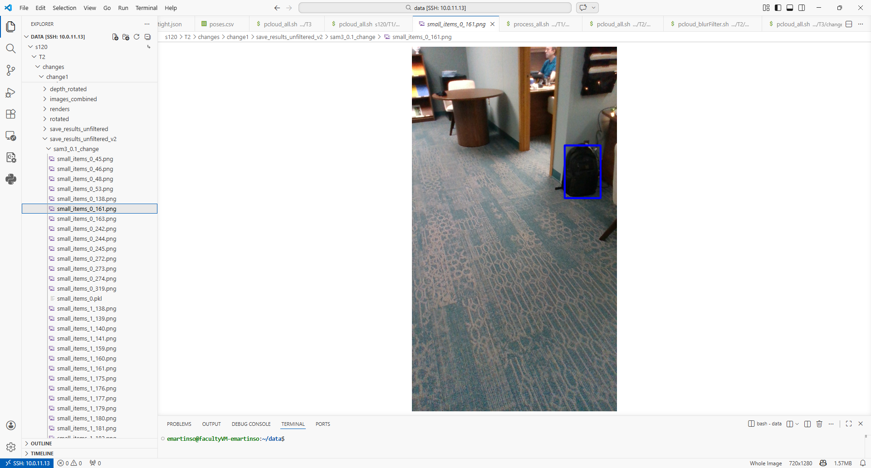
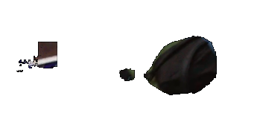
System Architecture
Object Detection Baseline
Data
Open Vocab Object Detection
Pointcloud Creation
Clustering
Change Detection Filter
Images
Segmen-tation
Object
cloud
Clusters
Detections
Step-by-Step Flow:
2D Open-Vocabulary Segmentations via SAM 3 based on analyst queries.
3D Projection & Spatial Filtering (discarding redundant captures within 5 cm or 0.05 rad to reduce load by ~75%).
Spatial Clustering using DBSCAN to group 3D points into persistent object hypotheses.

Slide 5
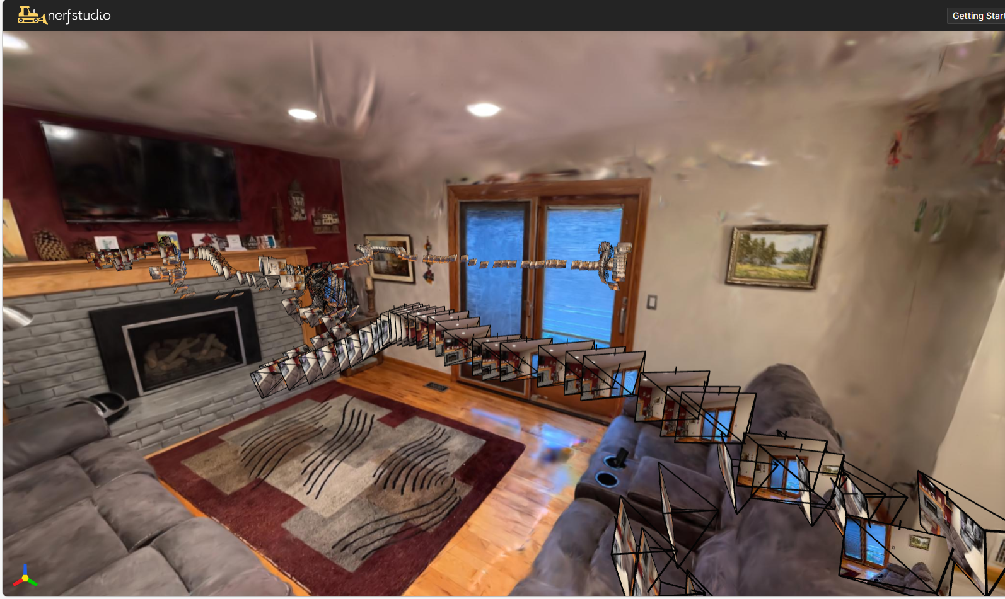
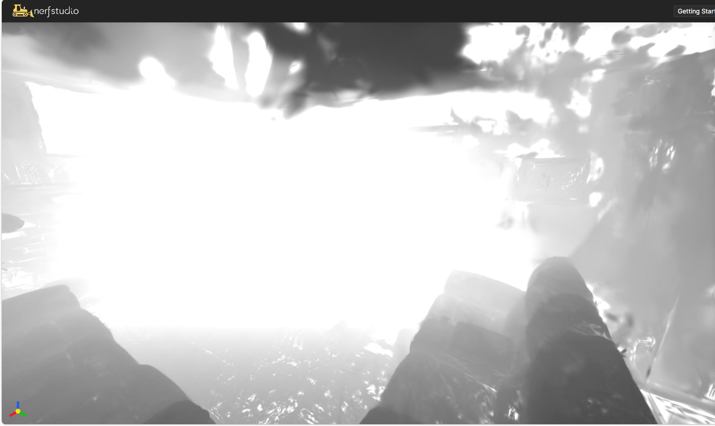
Spatial Alignment & Depth Synthesis
Open vocabulary object detection processes every image – generating thousands of false positive detections
The baseline detection architecture reduces error by generating point clouds and then applying clustering in 3D
This requires accurate image registration and depth image
Image registration is handled by COLMAP, which works with color only
RGB-D images and/or GPS can also be integrated to reduce error
Depth images can be generated with an RGB-D sensor, or created synthetically with Gaussian Splatting
Color
Depth
Synthetic Depth Image created by Gaussian Splatting

Slide 6

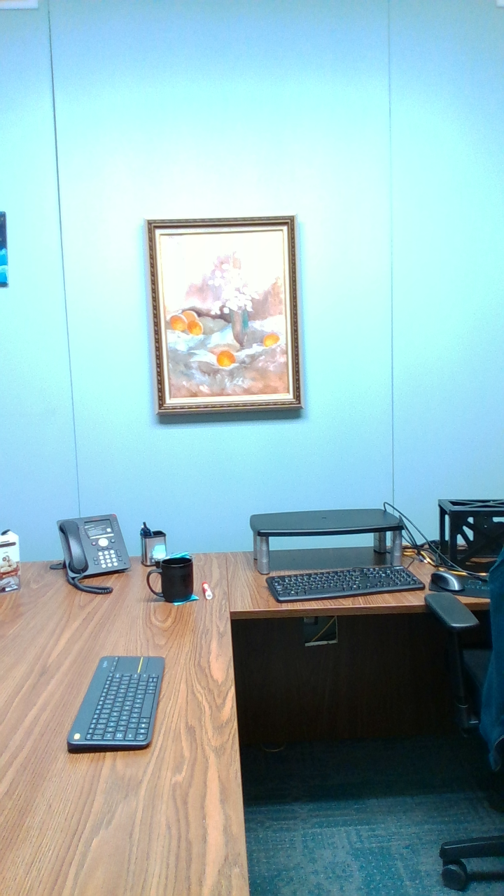
Detecting Change?
Capture videos at two different times in the same environment.
These do not have to be from exactly the same positions or cover exactly the same area
Register the second video into the same transformation space as the first
Same COLMAP utility
Add images to the existing model
Now use an VLM to analyze images captured of the same cluster at different times … How?
Before
After
Can we just ask the LLM what has changed?
Too many unimportant things are different

Slide 7
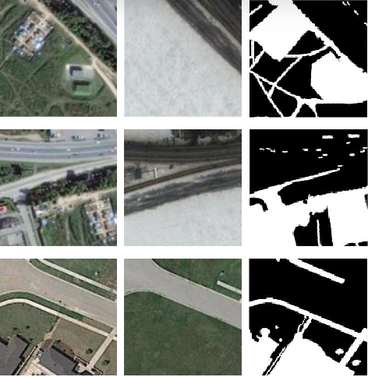




Classic Change Detection
“After” Image
Neural Network
Align images captured from two different runs
Use a neural network to identify the differences between them
Change mask – segmentation image identifying each pixel as belonging to change or not
Bounding boxes – boxes drawn around significant areas of change in the image
Change: Mask or Bounding Boxes
“Before” Image
Proposed New Process
New Image
Has the object in question changed?
Nearest “Old” Image
Repeat and average outputs over many images

Slide 8
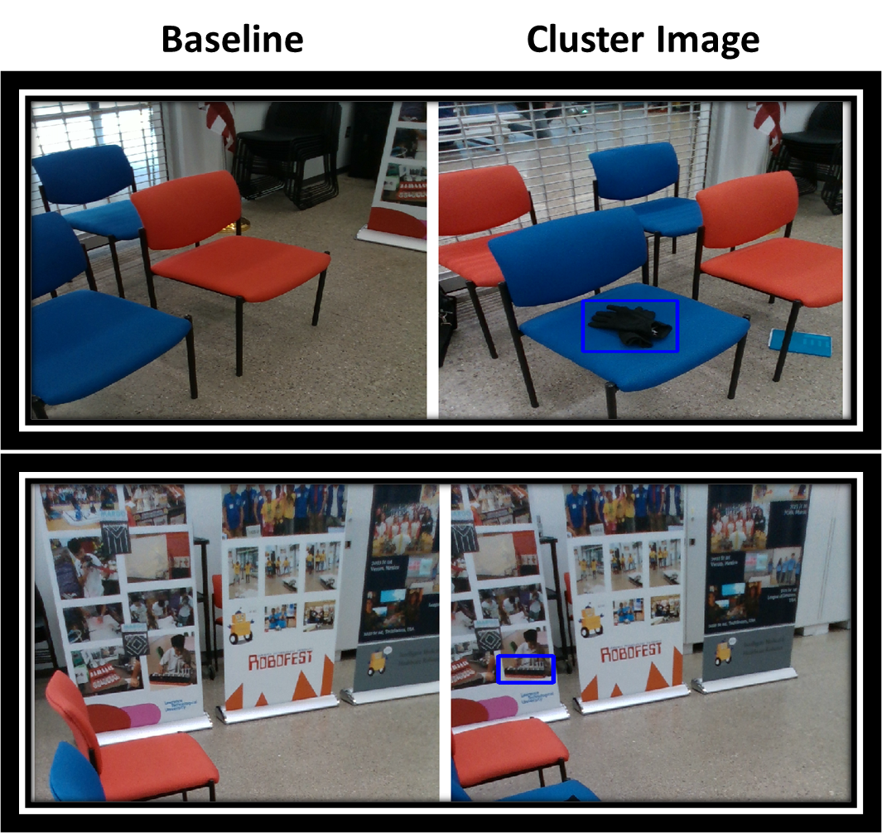
Instructing the LLM Change Filter
For each 3D cluster:
Nearest matching frames from the baseline "cleared" run are identified using a distance/angle sum-of-Gaussians function
Baseline and current frames are merged side-by-side with a bounding box drawn around the candidate object.
Merged image pairs are passed to a VLM with a structured prompt asking if a new object is present inside the box.
Outputs a structured JSON response ({'is_new_object': True/False}).
Averaging N sample responses yields a change likelihood score, overcoming minor registration alignment errors.

Slide 9
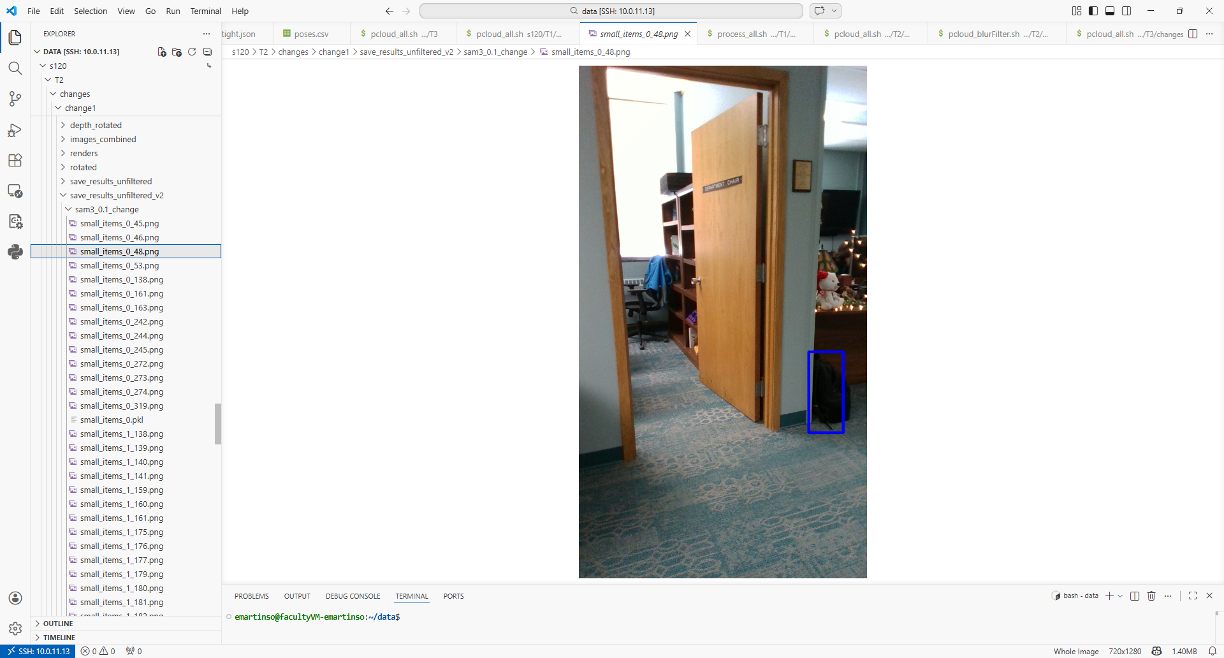
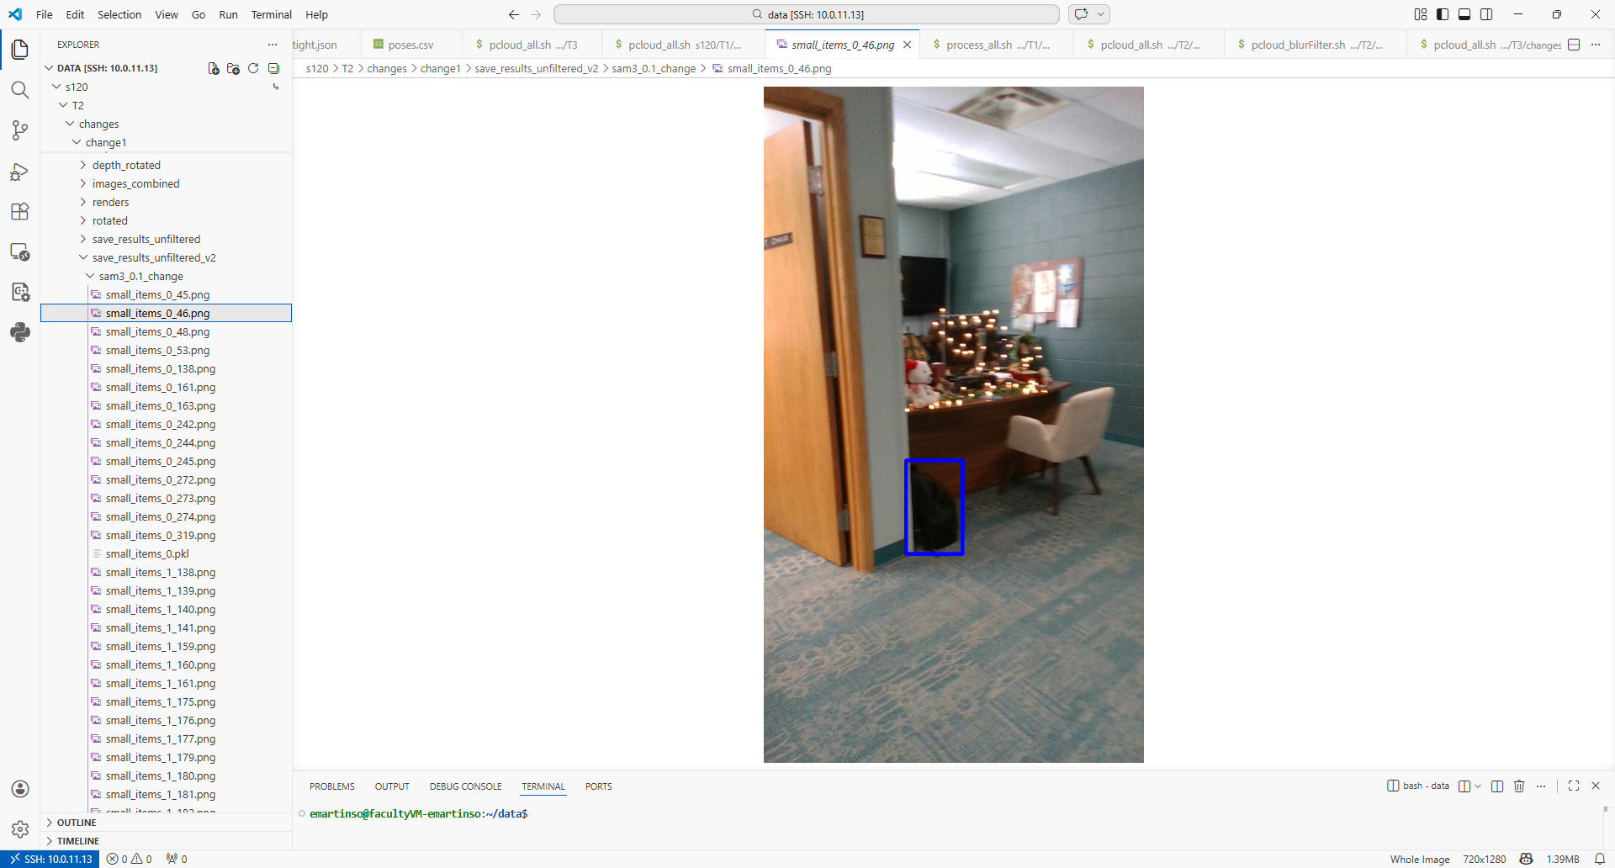
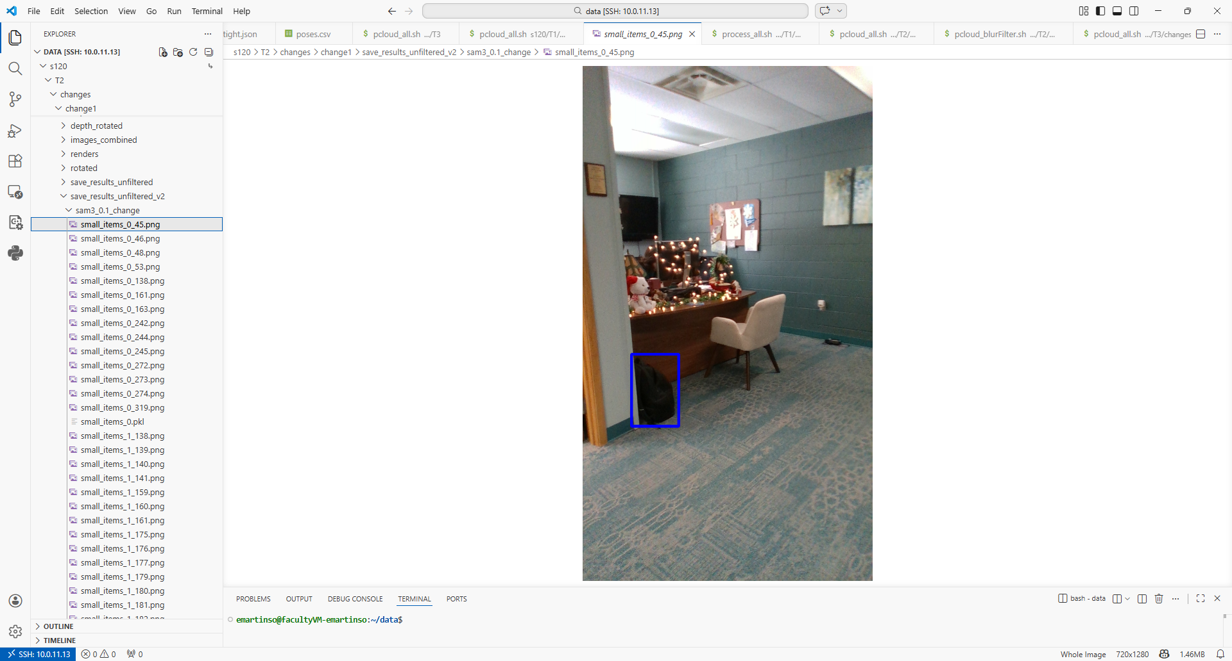
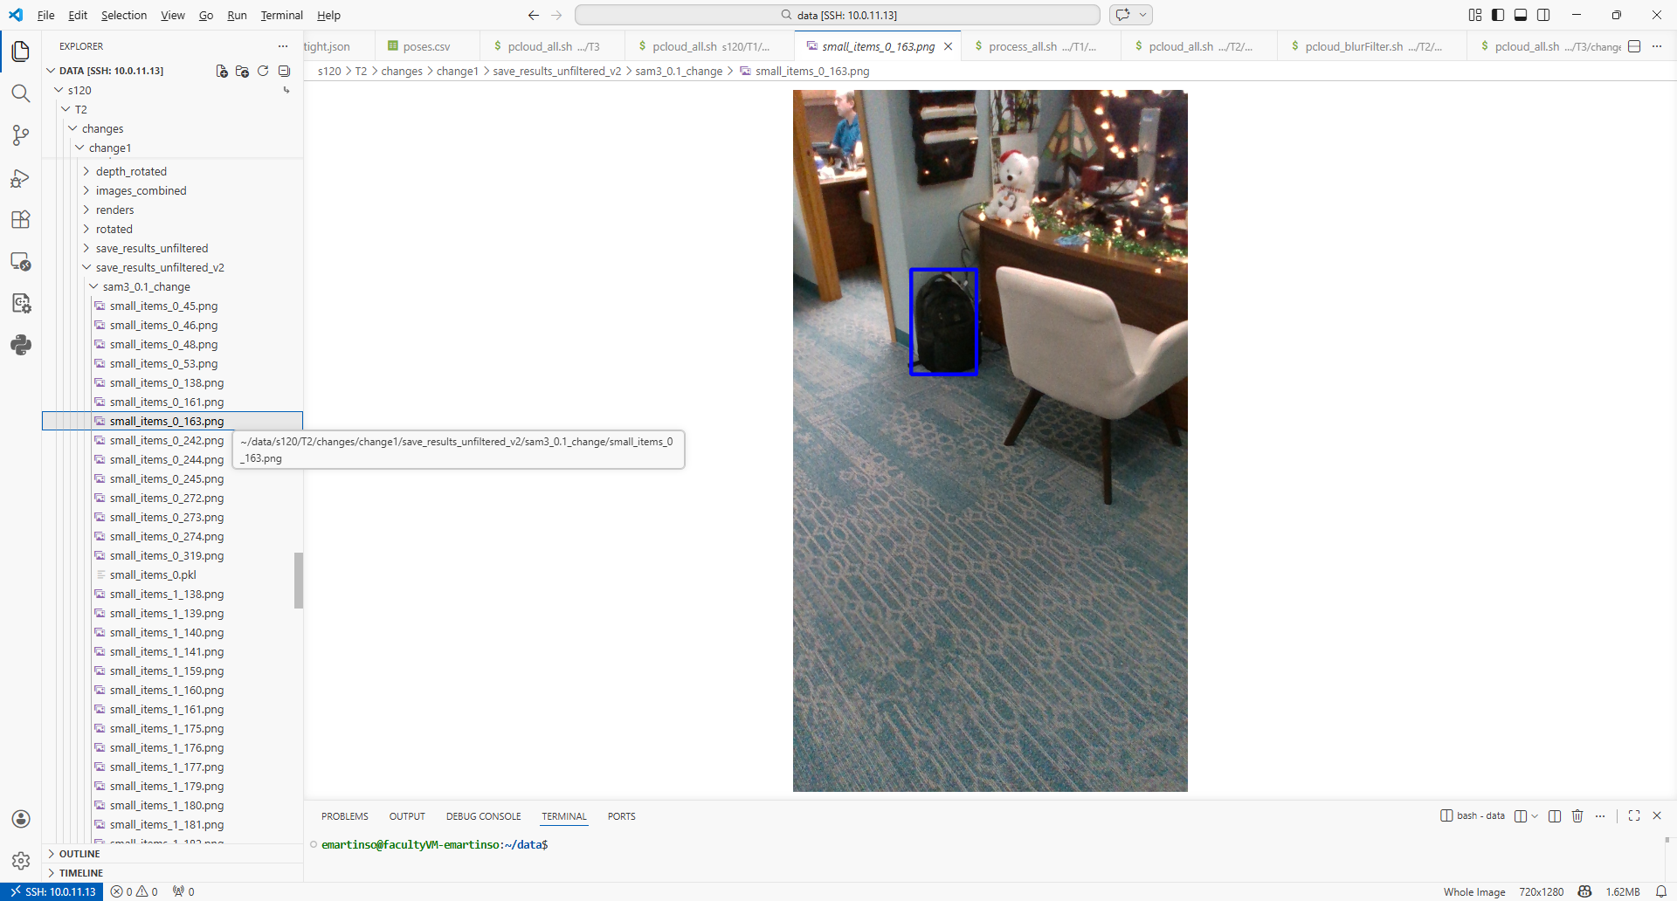
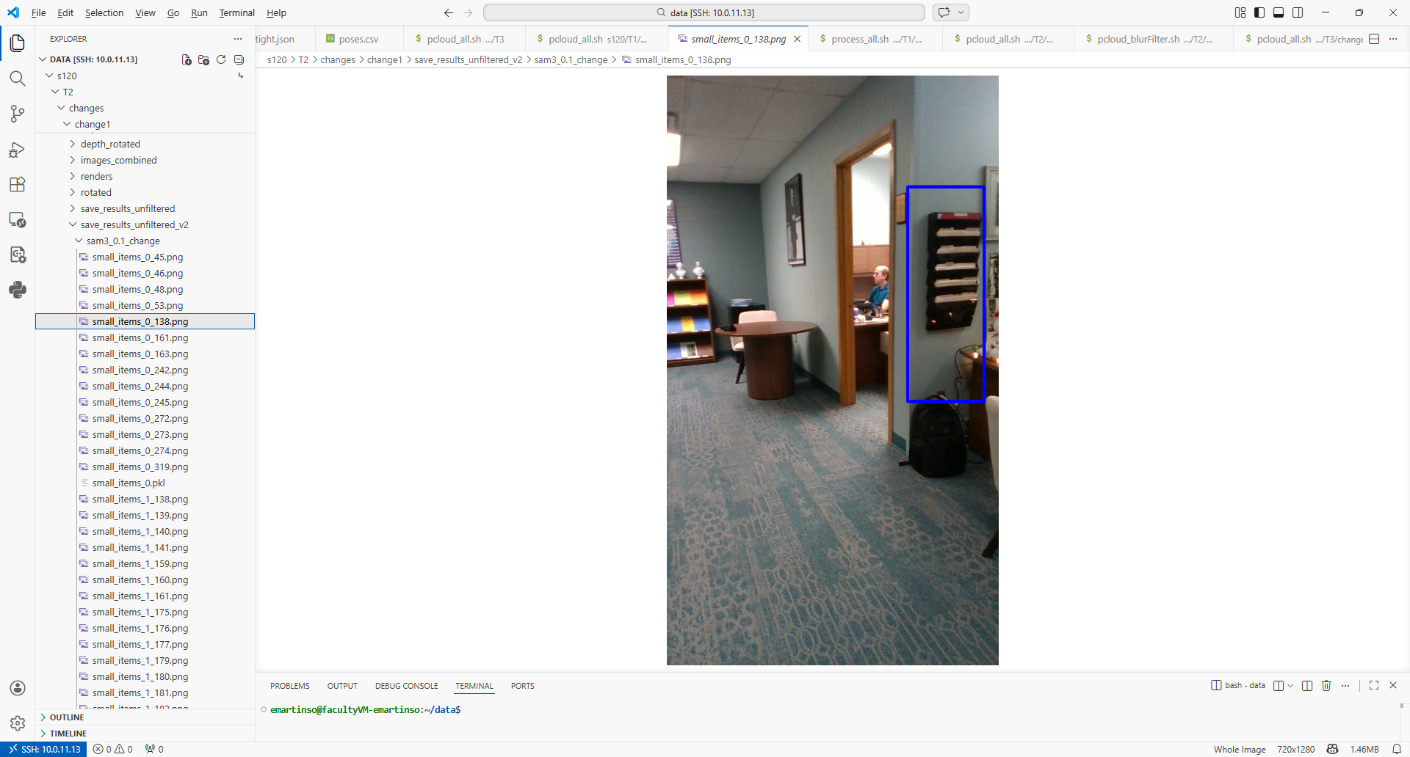
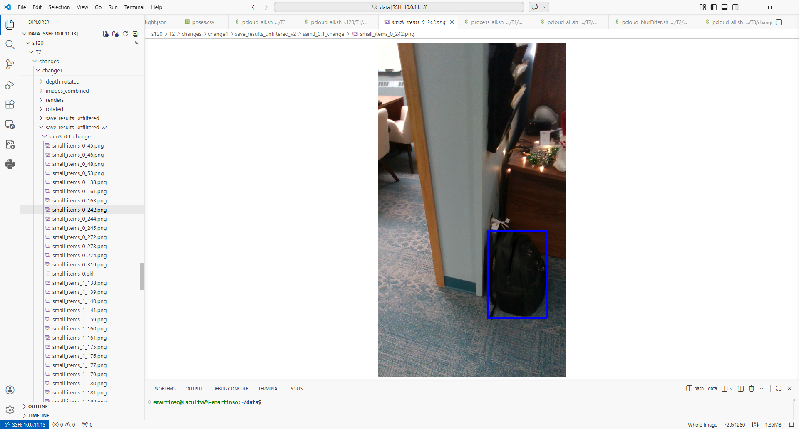
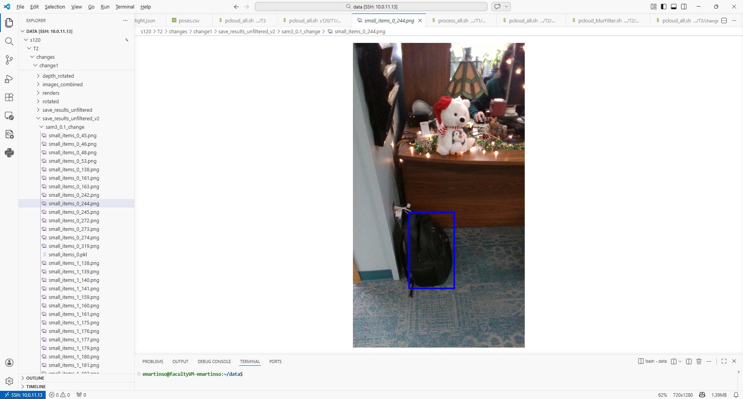
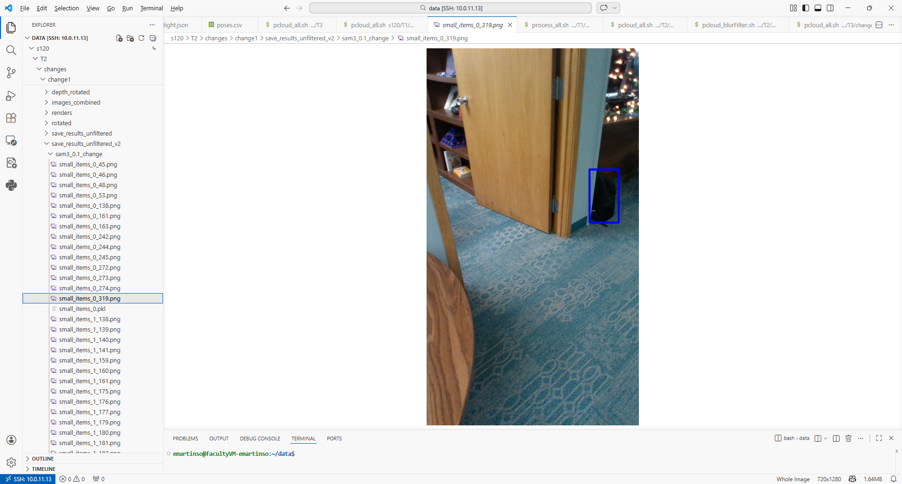
Filtering Example
Images on the right were extracted for a single cluster:
8 of 9 images are correct, and SAM3 has identified a backpack
1 image is wrong
          SAM3 identified a backpack incorrectly
          Image was localized badly
          Send all of these images to the VLM for processing along with their nearest neighbor in the “before” image set
          VLM could also get some wrong – with lighter weight models making more mistakes
            Average the results to improve accuracy

Slide 10
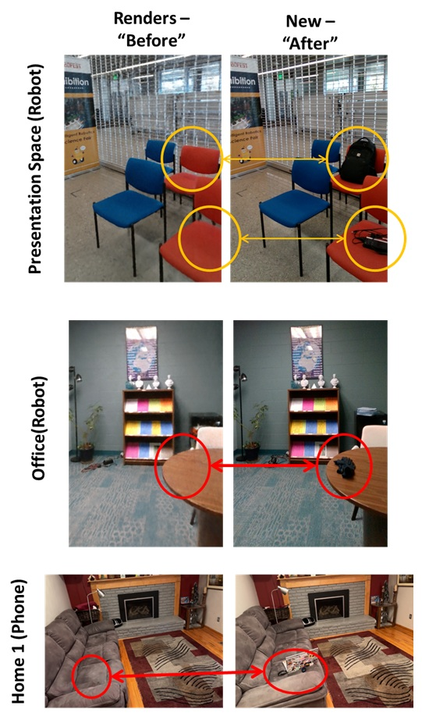
Evaluation
“Before”
Testing Platforms:
Handheld Mobile Phone
Stretch-2 Mobile Robot
3 Testing Environments:
Home (Mobile Phone): 5m x 4m space; Gaussian Splatting used for synthetic depth; high noise (4 trials).
Presentation Space (Robot): 4m x 4m area with heavy visual poster clutter on walls (10 trials).
Office (Robot): 6.5m x 2.5m active office with natural human movement and dynamic occlusions (5 trials).
Target Queries:
Specific items - clothing, dishes, electronics,
Broad concepts – general clutter, small items, trash

Slide 11
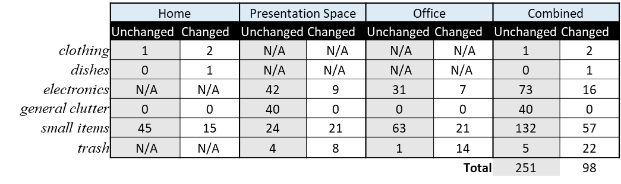
Baseline Performance
Across 9 trials, 3 environments, and 4 object queries per environment:
SAM3 + Clustering (Baseline Detection) identified 251 candidate clusters
Only 98 / 251 clusters represented actual changes
A perfect filter would reduce the number of objects to review by 61%

Slide 12
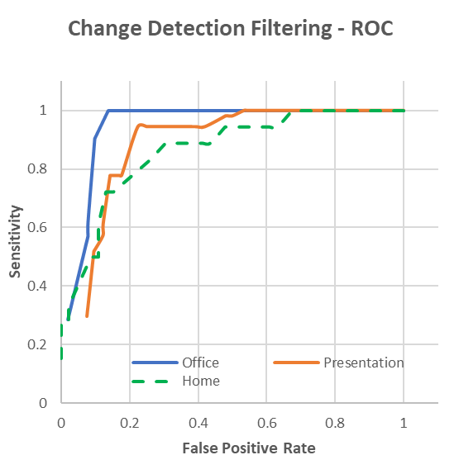
Experimental Results –
ROC Curve Analysis
Office:
  Very good baseline separation
  100% sensitivity with high specificity
Presentation Space:
Drops 80% of unchanged objects while retaining 90% of actual changes
Highly cluttered visual space
Home:
Noisy monocular synthetic depth
>80% of unchanged items are discarded at 80% recall.

Slide 13
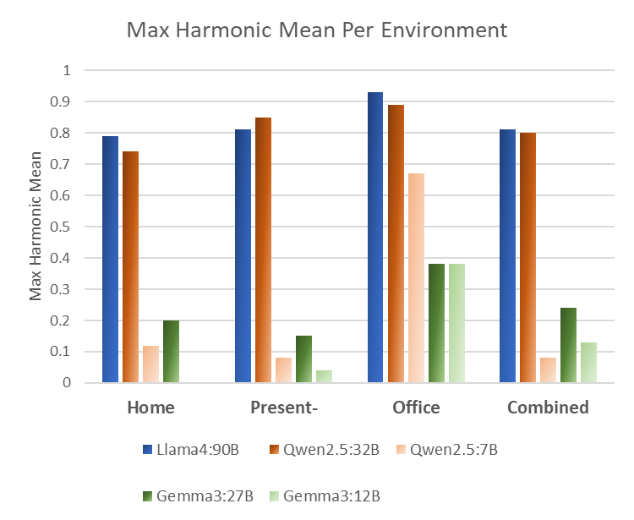
Experimental Results -
VLM Model Comparison
Evaluated Models
Llama 4 (90B), Qwen 2.5 (7B, 32B), Gemma 3 (12B, 27B).
Metric
HM emphasizes the importance of removing as many unchanged objects as possible while dropping few changed objects
Results
Llama 4 (90B) yielded the best overall performance (HM = 0.81).
Qwen 2.5 (32B) matched Llama 4's performance (HM = 0.80) while requiring less than half the parameters—ideal for edge compute constraints.
Smaller VLM variants (<12B) struggled significantly with fine-grained side-by-side spatial reasoning.
2 * Specificity * Sensitivity
Harmonic Mean =
Specificity + Sensitivity

Slide 14

Operational Latency Challenge
COLMAP Image Registration:
  Computationally heavy when registering incoming video streams against baseline runs.
  Future Work: Parallelizing spatial registration chunks
Large VLM Inference:
High parameter models increase per-query latency on tactical hardware.
Future Work: Fine-tuning domain-specific, lightweight VLM models optimized strictly for side-by-side change verification to run on low-power tactical GPUs.

Slide 15
Conclusion
Temporal change filtering powered by VLMs significantly improves the high false-positive rate of open-vocabulary object detection systems, eliminating up to 80% of unnecessary analyst review workload.
Significant potential for ISR missions
Future Work
Evaluating larger, operational ISR datasets with realistic military threat classes.
Integrate operational knowledge (SIGINT or mission reports)
Deployment optimizations for edge hardware

